Slide 1
Interfaces & Polymorphism
Dr. Jeff Hill

Slide 2
Interface
Remember these are referred to as “class lite”?
Defines abstract methods that class(es) must provide concrete method implementations for
A class can extend a superclass (inheritance) and simultaneously implement an interface
Remember, Java only allows for single-inheritance
There is no such limitation with interfaces
We can implement as many (or as few) as we need
This is one reason why Java has never been retrofitted with multiple-inheritance
Many more modern languages support multiple-inheritance
We can do just about everything we need with single-inheritance and interfaces

Slide 3
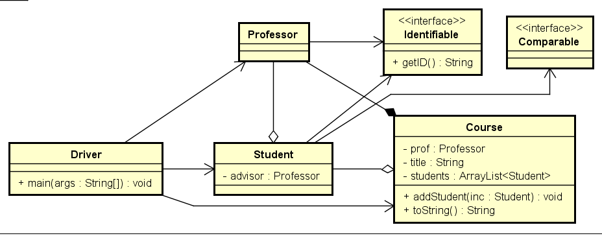
Polymorphic interfaces
Diagram simplified for brevity, not showing ctors and accessors
One of the last things we discussed with the lesson on interfaces
Interfaces can be used as a type
Since multiple classes can implement any given interface…
This means that interface references can be polymorphic
These are valid instantiations given the above class diagram
Identifiable stuOne = new Student(“Grace”,”Hopper”,”ABC123”);
Identifiable profOne = new Professor(“Jeff”,”Hill”,”XYZ987”);
This means we can put Student and Professor objects into a single collection of <Identifiable> type and manage all objects together!

Slide 4
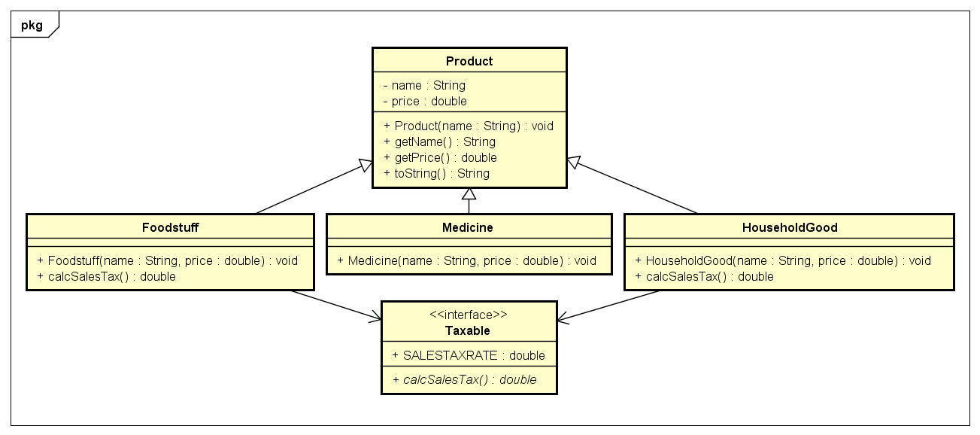
Example
Products in a typical convenience store
We’ll assume all foodstuffs and household goods are taxable and medicines are not taxable
Real world – this isn’t true, we’d need a more complex solution!
Some food isn’t taxable, some medicines are
Varies across locales, one-size-fits-all solutions rarely work in the real world!
Because all products aren’t taxable, putting tax functionality in the superclass isn’t appropriate
We want to make sure non-taxable items aren’t accidently taxed so just letting the taxable functions exist in the Medicine class isn’t a safe solution
But we’re limited to single-inheritance…
This is where combining with interfaces gets us to a workable solution

Slide 5
Example
Refer to Handout 13 code – too complex for slides
Driver’s main method lines 8 – 21

Slide 6
Explicit type casting
The main problem with polymorphic reference variables is…
They can only “see” methods associated with their type
Superclasses can’t “see” subclass members…
Interfaces can’t “see” the actual class members…
Java provides a mechanism to tell the compiler to treat a reference variable of some previously defined type as a different type
The IDE will take your word for it if you explicitly cast a String into an Integer for example
But, if the two types are not compatible, the program will crash at runtime!

Slide 7
Example
Refer to Handout 13 code – too complex for slides
Driver’s main method lines 30 – 35

Slide 8
instanceof
Java provides the instanceof keyword to allow us to test the types of reference variables
Returns a Boolean true or false as appropriate for a given object
This is how we can prevent crashing in collections where we have a bunch of mixed types that all won’t be castable to some certain subclass or base class

Slide 9
Example
Refer to Handout 13 code – too complex for slides
Driver’s main method lines 37 – 52

Slide 10
Questions?

